Slide 1
Software Engineering
Dr. Chandan Kumar
Department of Computer Science
Amrita Vishwa Vidyapeetham

Slide 2
Software Development Life Cycle Models (SDLC)

Slide 3
SDLC
The goal of Software Engineering is to provide models and processes that lead to the production of well-documented maintainable software in a manner that is predictable.
The Software Development Life Cycle (SDLC) is a framework defining tasks performed at each step in the software development process. It is a structure followed by a development team within the software organization. It consists of a detailed plan describing how to develop, maintain and replace specific software. It defines a methodology for improving the quality of software and the overall development process.
There are different types of SDLC Models like: Waterfall Model, V-Model, Prototype Model, Incremental Model, Iterative Model, Spiral Model and Agile Model.

Slide 4
Build & Fix Model
Product is constructed without specifications or any attempt at design
Adhoc approach and not well defined
Simple two-phase model
Suitable for small programming exercises of 100 or 200 lines.
Unsatisfactory for software for any reasonable size
Code soon becomes unfixable
No room for structured design
Maintenance is practically not possible
Build
Code
Fix

Slide 5
Waterfall Model
Sometimes called the classic life cycle or linear sequential model. It suggests a systematic, sequential approach to software development that begins at the system level and progresses through analysis, design, coding, testing, and support. It is proposed by Winston W. Royce in 1970
System Engineering
Requirement Analysis and Project Planning
Design
Code
Testing
Support

Slide 6
Phases of Waterfall Model
The first step is the system engineering step where we try to understand the overall problem and identify which of the problem elements are to be handled through the software. So, one of the goals in system engineering is to understand the overall context of the problem.
In the analysis phase we understand the problem domain of the user in more detail. We understand what kind of information is involved what kind of data is involved, what functions need to be performed, what are the performance and interfacing requirements. This part is the analysis part whose purpose is to identify or clearly define the requirements which are to be met thru the development of the software.

Slide 7
Phases of Waterfall Model
In the analysis phase we also try to carry out project planning either as a part of the same step or if it is large project, the project planning step may be made as a separate step. The purpose of project planning is to identify how we will carry out the project what are the different steps, what are the deliverables, and what would be the time frame what could be the resources allocated.
In the design phase we translate the requirements into the software architecture, prepare the database design and so on. So, this is a primarily a technical step and in this step the requirements are translated into an implementation framework, which will be implemented in the next phase that is the coding phase, in which the actual programming and implementation will be done.

Slide 8
Phases of Waterfall Model
After we have done the implementation or carried out the programming phase, when the individual units of the software are ready, we would get into the next phase called testing phase and integration phase.
In this all the individual pieces of the software are individually first tested, and then the whole software is put together. The objective is to test first the logic of individual modules. And then when we put all of them together, we want to test their interfaces, so that they work collectively in a way they were intended to work. This is the testing and integration phase, and this is followed by actual deployment of the software.

Slide 9
Phases of Waterfall Model
Now the software is ready. It is deployed and implemented. The user will take control and will start using the software.
After the deployment there is an ongoing maintenance (support) phase.
In the maintenance phase, we have to make the necessary changes; if any errors are encountered, we will have to remove the errors. In this phase, the software is either enhanced or is perfected or is ported to new hardware or new machines.

Slide 10
Deliverables in Waterfall Model
Each of the steps has certain deliverable.
Project Plan & Feasibility Study
Requirement Document (SRS)
System Design Document
Details Design Document
Source Code
Test Plan & Test Reports
Software Manuals

Slide 11
Advantages of Waterfall Model
Advantages of waterfall model:
This model is simple and easy to understand and use.
It is easy to manage due to the rigidity of the model – each phase has specific deliverables and a review process.
In this model phases are processed and completed one at a time. Phases do not overlap.
Waterfall model works well for smaller projects where requirements are very well understood.

Slide 12
Disadvantages of Waterfall Model
Disadvantages of waterfall model:
Once an application is in the testing stage, it is very difficult to go back and change something that was not well-thought out in the concept stage.
No working software is produced until late during the life cycle.
High amounts of risk and uncertainty.
Not a good model for complex and object-oriented projects.
Poor model for long and ongoing projects.
Not suitable for the projects where requirements are at a moderate to high risk of changing.

Slide 13
When to Use Waterfall Model
This model is used only when the requirements are very well known, clear and fixed.
Product definition is stable.
Technology is understood.
There are no ambiguous requirements
Sufficient resources with required expertise are available freely
The project is short.

Slide 14
V Model
One of the major problem in waterfall model was that defects were found at a very later state of the development process, since testing was done at the end of the development cycle. It became very challenging and costly to fix the defects since it were found at a very later stage. To overcome this problem, a new development model was introduced In 1979, by Barry W. Boehm called the “V Model”
V model is now one of the most widely used software development process. Introduction of V model has proved the implementation of testing right from the requirement phase. V model is also called as verification and validation model.

Slide 15
V Model
To understand the V model, let’s first understand what is verification and validation in software.
Verification: Verification is a static analysis technique. In this technique testing is done without executing the code. Examples include – Reviews, Inspection and walkthrough.
Validation: Validation is a dynamic analysis technique where testing is done by executing the code. Examples include functional and non-functional testing techniques.
In V model, the development and QA activities are done simultaneously. There is no discrete phase called Testing, rather testing starts right from the requirement phase.

Slide 16
A Visual diagram of V Model
BRS
Acceptance Testing
SRS
System Testing
HLD
Integration Testing
LLD
Component Testing
Coding
Unit Testing
Code

Slide 17
Phases of V Model
The various phases of the V-model are as follows:
Requirements like Business Requirement Specification (BRS) and System Requirement Specification (SRS) begin the life cycle model just like the waterfall model. But, in this model before development is started, a system test plan is created. The test plan focuses on meeting the functionality specified in the requirements gathering.
The high-level design (HLD) phase focuses on system architecture and design. It provide overview of solution, platform, system, product and service/process. An integration test plan is created in this phase as well in order to test the pieces of the software systems ability to work together.

Slide 18
Phases of V Model
The low-level design (LLD) phase is where the actual software components are designed. It defines the actual logic for each component of the system. Class diagram with all the methods and relation between classes comes under LLD. Component tests are created in this phase as well.
The implementation phase is, again, where all coding takes place. Once coding is complete, the path of execution continues up the right side of the V where the test plans developed earlier are now put to use.
Coding: This is at the bottom of the V-Shape model. Module design is converted into code by developers. Unit Testing is performed by the developers on the code written by them.

Slide 19
Advantages of V Model
Simple and easy to use.
Testing activities like planning, test designing happens well before coding. This saves a lot of time. Hence higher chance of success over the waterfall model.
Proactive defect tracking – that is defects are found at early stage.
Avoids the downward flow of the defects.
Works well for small projects where requirements are easily understood.

Slide 20
Disadvantages of V Model
Very rigid and least flexible.
Software is developed during the implementation phase, so no early prototypes of the software are produced.
If any changes happen in midway, then the test documents along with requirement documents must be updated.
Since, no prototypes are produced, there is a very high risk involved in meeting customer expectations.

Slide 21
When to Use V Model
The V-shaped model should be used for small to medium sized projects where requirements are clearly defined and fixed.
The V-Shaped model should be chosen when sufficient technical resources are available with needed technical expertise.

Slide 22
Prototype Model
The prototype model is used when the requirements are unclear. It is used when the customer is unclear about the details of the input, process and the output needs of the software.
Like other model's prototype model also starts with the communication phase between the software engineer and customer.
The main idea behind the Prototype model is that instead of freezing requirements before moving forward with design or coding, a throwaway prototype is created to gain a better understanding of the needs.

Slide 23
Prototype Model
The client can get an “actual feel” of the system by using prototype, since the interactions with prototype can enable the client to better understand the requirements of the desired system. So, Prototyping is an attractive idea for complicated and large systems.
The prototype is usually not a fully functional system, and many of the details are not included. The goal is to create a system that is functional in general.
Therefore, in the case of prototype the focus will be on what is unknown, or not properly understood.

Slide 24
Prototype Model
Many iterations may be required to incorporate the changes.
Every time we complete the prototype we will evaluate it, tune it and decide what needs to be done further.
Final product then would be built after the prototype is completed and is found to be acceptable.

Slide 25
A Visual diagram of Prototype Model
Start
Requirement Gathering
Quick Design
Building Prototype
Refine Prototype
Customer Evaluation
If Acceptance by Customer
Maintain
Test
Implement
Design

Slide 26
Advantages of Prototype Model
It is most appropriate for projects that suffer from technical, and requirements risks.
Users are actively participating in the development process.
User feedback is provided more quickly, resulting in better solutions.
It's simple to spot missing functionality.
Confusing or challenging functions can be found, requirements can be validated, and a partial but functioning application can be quickly implemented.

Slide 27
Disadvantages of Prototype Model
It can increase the cost of development for the projects.
Since the prototype is constructed only at the start of the project, so it is ineffective for risks identified later during the development cycle.
It may increase the complexity of the system as scope of the system may expand beyond original plans.

Slide 28
When to Use Prototype Model
Prototype model should be used when:
The desired system needs to have a lot of interaction with the end users.
The development is of highly optimized and efficient software is required.
The development of graphical user interface (GUI) is a part of an application.
The exact technical solutions are unclear for the development team.

Slide 29
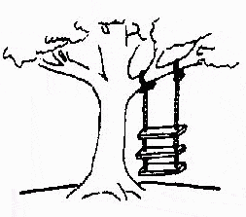
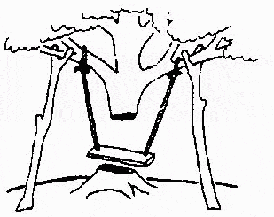
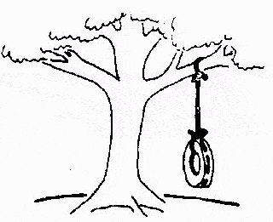
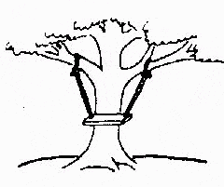
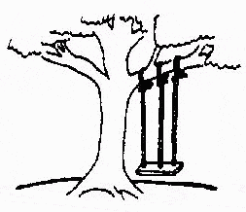

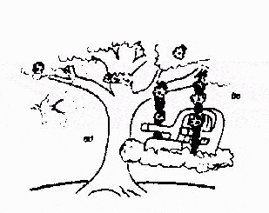
The Rapid Application Development (RAD) Model
Developed by IBM in 1980
User participation is essential
This is how the problem is solved now
The requirements specification was defined like this
The developers understood it in that way
This is how the problem was solved before.
This is how the program is described by marketing department
This, in fact, is what the customer wanted …
That is the program after debugging

Slide 30
The Rapid Application Development (RAD) Model
Build a rapid prototype
Give it to user for evaluation & obtain feedback
Prototype is refined
With active participation of users
Requirements
Planning
User
Description
Construction
Cut over

Slide 31
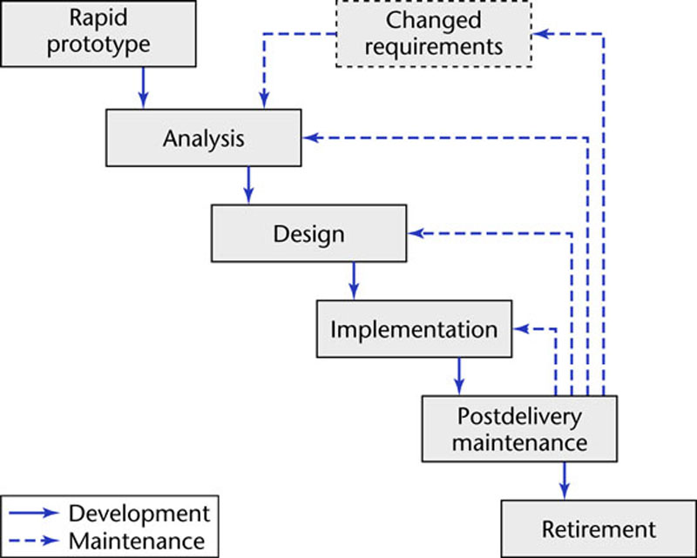
RAD Prototyping Model
Linear model
“Rapid”

Slide 32
The Rapid Application Development (RAD) Model
Not an appropriate model in the absence of user participation.
Reusable components are required to reduce development time.
Highly specialized & skilled developers are required and such developers are not easily available.

Slide 33
Incremental Model
Incremental model is a type of software development model like Waterfall model, V-model, etc..
In incremental model the whole requirement is divided into various builds. Multiple development cycles take place here, making the life cycle a “multi-waterfall” cycle.
Cycles are divided up into smaller, more easily managed modules.
In this model, each module passes through the requirements, design, implementation and testing phases.
After every cycle a useable product is given to the customer.
Popular particularly when we have to quickly deliver a limited functionality system.

Slide 34
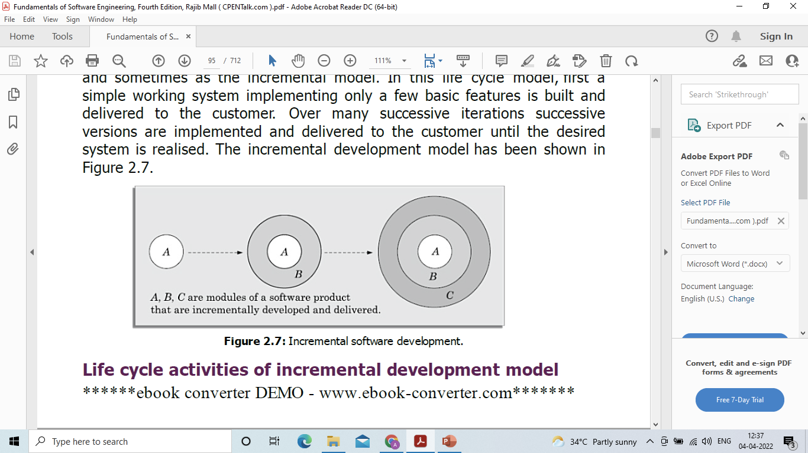
Incremental Model
A working version of software is produced during the first module, so you have working software early on during the software life cycle. Each subsequent release of the module adds function to the previous release. The process continues till the complete system is achieved.

Slide 35
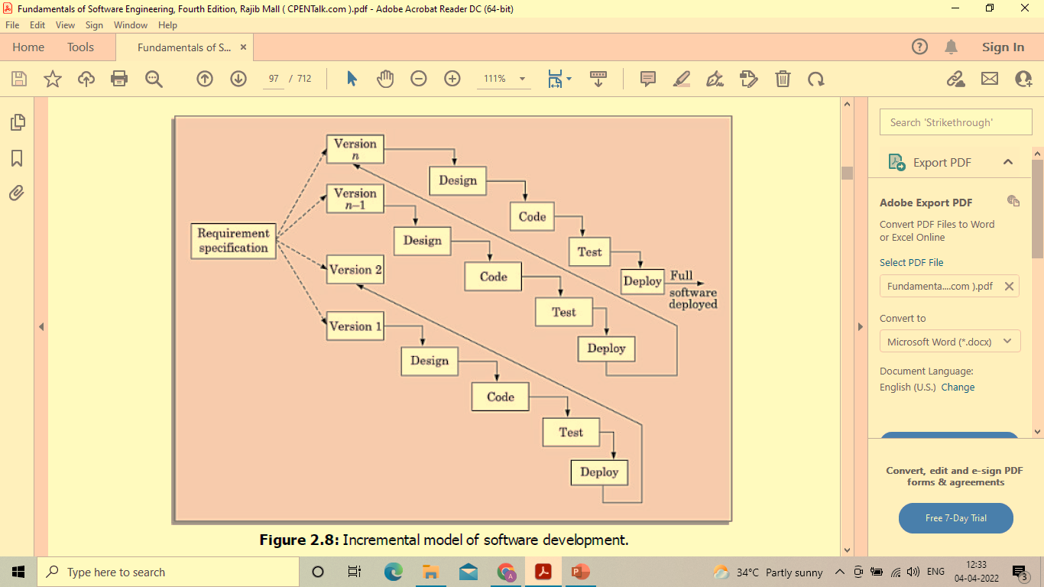
Incremental Model

Slide 36
Advantages of Incremental Model
Popular, especially when we need to deploy a software with minimal functionality rapidly.
This model is more flexible – less costly to change scope and requirements.
A smaller iteration makes testing and debugging easier.
Customers can respond to each built in this model.
Error reduction-the core modules are used by the customer from the beginning and therefore these get tested thoroughly.
Risk is easier to manage since risky modules are detected and dealt with during the iteration.

Slide 37
Disadvantages of Incremental Model
Careful planning and design required.
Before the system can be broken down and constructed incrementally, it must have a clear and thorough definition.
Total cost is higher than waterfall.

Slide 38
When to Use Incremental Model
When the requirements of the entire system are clearly specified and understood, this model can be applied.
When need to get a product to the market early.
When new technology is being used.
When no resources are available with the required skill set.
When some high-risk features and goals are required.

Slide 39
Iterative Enhancement Model
This model has the same phases as the waterfall model, but with fewer restrictions. Generally the phases occur in the same order as in the waterfall model, but they may be conducted in several cycles. Useable product is released at the end of the each cycle, with each release providing additional functionality.
Customers and developers specify as many requirements as possible and prepare a SRS document.
Developers and customers then prioritize these requirements
Developers implement the specified requirements in one or more cycles of design, implementation and test based on the defined priorities.

Slide 40
Iterative Enhancement Model
Requirements
specification
Architectural
design
Detailed
design
Implementation
and unit testing
Integration
and testing
Operation and
Maintenance

Slide 41
Evolutionary Process Models
Evolutionary process model resembles iterative enhancement model. The same phases as defined for the waterfall model occur here in a cyclical fashion. This model differs from iterative enhancement model in the sense that this does not require a useable product at the end of each cycle. In evolutionary development, requirements are implemented by category rather than by priority.
This model is useful for projects using new technology that is not well understood. This is also used for complex projects where all functionality must be delivered at one time, but the requirements are unstable or not well understood at the beginning.

Slide 42
Evolutionary Process Model

Slide 43
Evolutionary Process Model
Evolutionary model is the combination of iterative and incremental approach of software development.
Evolutionary model resembles iterative enhancement model. The same phases as defined for the waterfall model occur here in a cyclical fashion.
This model has many of the features of the incremental model.
In evolutionary development, requirements are implemented by category rather than by priority.

Slide 44
Evolutionary Process Model
In the evolutionary model, the requirements, plan, estimates, and solution evolve over the iterations, rather than fully defined and frozen in a major up-front specification effort before the development iterations begin.
Evolutionary software development process is sometimes referred to as design a little, build a little, test a little, deploy a little model.

Slide 45
Evolutionary Process Model
Rough Requirements Specifications
Identify the core and other parts to be developed incrementally
Develop the core part using an iterative waterfall model
Delivery of the next version to the customer
Collect customer feedback and modify requirements
Develop the next identified features using an iterative waterfall model
All Features Complete
Maintenance

Slide 46
Advantages of Evolutionary Model
Risk analysis is better.
It supports changing environment.
Initial operating time is less.
Better suited for large mission-critical projects.
During the life cycle software is produced early which facilitates customer evaluation and feedback.

Slide 47
Disadvantages of Evolutionary Model
Design can become ad hoc without special attention to maintainability and optimality. Because only the current increment is designed at a time.
Management complexity is more. It is difficult to divide the required features into several parts that can be incrementally implemented and delivered.
Highly skilled resources are required for risk analysis.
Not suitable for smaller projects.
Can be costly to use.

Slide 48
When to Use Evolutionary Model
This model is useful for projects using new technology that is not well understood.
This is also used for complex projects where all functionality must be delivered, but the requirements are unstable or not well understood at the beginning.
Very useful for large projects.
Well suited for projects using object-oriented development.
When a client prefers to have the product in increments.

Slide 49
Spiral Model
Models do not deal with uncertainly which is inherent to software projects.
Important software projects have failed because project risks were neglected & nobody was prepared when something unforeseen happened.
Barry Boehm recognized this and tired to incorporate the “project risk” factor into a life cycle model.
The result is the spiral model, which was presented in 1986.

Slide 50
Spiral Model
The radial dimension of the model represents the cumulative costs. Each path around the spiral is indicative of increased costs. The angular dimension represents the progress made in completing each cycle. Each loop of the spiral from X-axis clockwise through 360º represents one phase. One phase is split roughly into four sectors of major activities.
Planning: Determination of objectives, alternatives & constraints.
Risk Analysis: Analyze alternatives and attempts to identify and resolve the risks involved.
Development: Product development and testing product.
Assessment: Customer evaluation

Slide 51
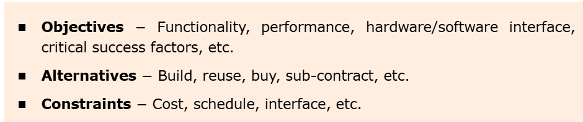
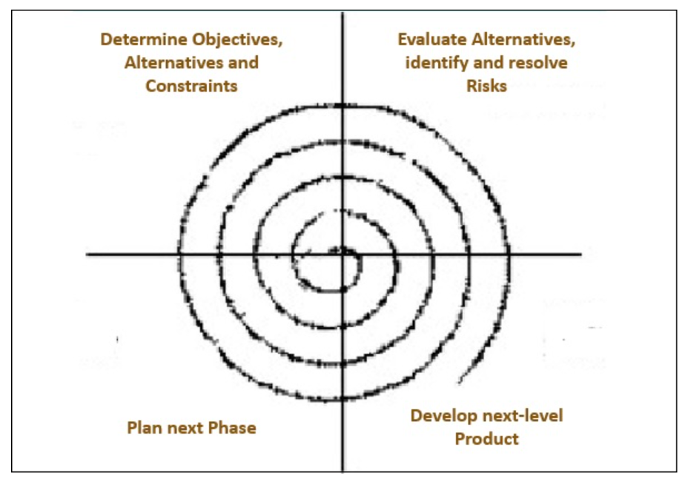
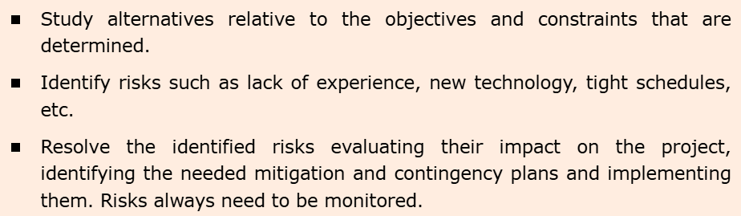
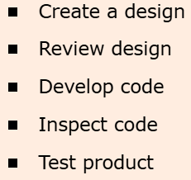
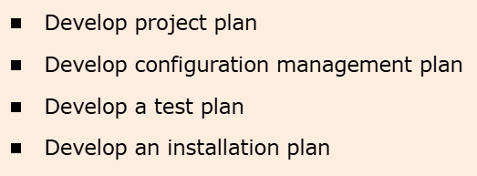
Quadrant 1 - Determine objectives, alternatives and constraints
Quadrant 2 - Evaluate alternatives, identify and resolve risks
Spiral model has four quadrants
Quadrant 4 - Plan next phase
Quadrant 3 - Develop next-level product

Slide 52
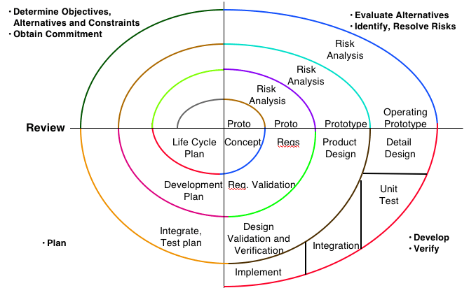
Spiral Model

Slide 53
Advantages of Spiral Model
As a result of the extensive risk analysis, risk avoidance is improved.
It's ideal for big, mission-critical projects.
Strong approval and documentation control.
Additional Functionality can be added later.
Software is produced early in the software life cycle.

Slide 54
Disadvantages of Spiral Model
Can be a costly model to use.
Risk analysis requires highly specific expertise.
Project’s success is highly dependent on the risk analysis phase.
Doesn’t work well for smaller projects.
Model has not been used as widely as the linear sequential or prototyping paradigms.

Slide 55
When to Use Spiral Model
When deliverance is required to be frequent.
When costs and risk evaluation is important
For medium to high-risk projects
Users are unsure of their needs
Requirements are complex
Large and High Budget Projects
Significant changes are expected

Slide 56
Background behind Agile Model
Over the last two decades or so, projects using iterative waterfall-based life cycle models are becoming rare due to the rapid shift in the characteristics of the software development projects over time.
Two changes that are becoming noticeable are rapid shift from development of software products to development of customized software and the increased emphasis and scope for reuse.
The main difficulties included handling change requests from customers during product development, and the unreasonably high cost and time that is incurred while developing customized applications.

Slide 57
Cont..
Since customization essentially involves reusing most of the parts of an existing application and consists of only carrying out minor modifications by writing minimal amounts of code.
For such development projects, the need for more appropriate development models was deeply felt, and many researchers started to investigate in this direction.

Slide 58
Agile Model
Agile development model is a type of Incremental model. Software is developed in incremental, rapid cycles.
This results in small incremental releases with each release building on previous functionality.
Each release is thoroughly tested to ensure software quality is maintained. It is used for time critical applications.
In the Agile methodology, each project is broken up into several ‘Iterations’. All Iterations should be of the same time duration (between 1 to 4 weeks). At the end of each iteration, a working product should be delivered.

Slide 59
Agile Model
Sprint Planning
Development
Test
Launch
Teams decide which tasks to complete in an upcoming sprint and how that work will be achieved
Support and Feedback
A project is divided into small parts of work that can be incrementally developed and delivered over time are called sprints.
Iterations 1 to N
Incremental wise and add additional/ new functionality to the previous one.
Iteration wise Integration Testing

Slide 60
Agile Model
In Agile software development, the team will decide the basic core features that are required in the product and decide which of these features can be developed in the first iteration.
Any remaining features that cannot be delivered in the first iteration will be taken up in the next iteration or subsequent iterations, based on priority.
At the end of the first iterations, the team will deliver a working software with the features that were finalized for that iteration.

Slide 61
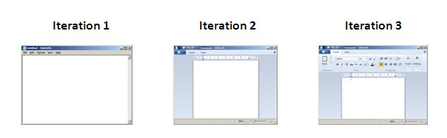
Agile Model
As per 12th Annual State of Agile Report, 98% of respondents said that they had success with agile projects in their organization. 74% indicated more than half of their agile projects had been successful. Reasons and Benefits for Adopting Agile are also presented in the report.

Slide 62
Agile Model
Some Agile-based software development methods are:
eXtreme Programming(XP)
Scrum
Crystal
Lean Software Development
Dynamic Software Development Method(DSDM)
Feature Driven Development(FDD)
*Agile’s may have 3 categories: Iterative, Incremental, and Evolutionary

Slide 63
Advantages of Agile Model
Customer satisfaction by rapid, continuous delivery of useful software.
People and interactions are emphasized rather than process and tools. Customers, developers and testers constantly interact with each other.
Working software is delivered frequently (weeks rather than months).
Face-to-face conversation is the best form of communication.

Slide 64
Cont..
Close, cooperation between businesspeople and developers.
Continuous attention to technical excellence and good design.
Regular adaptation to changing circumstances.
Even late changes in requirements are welcomed

Slide 65
Disadvantages of Agile Model
In case of some software deliverables, especially the large ones, it is difficult to assess the effort required at the beginning of the software development life cycle.
There is lack of emphasis on necessary designing and documentation.
The project can easily get taken off track if the customer representative is not clear what final outcome that they want.
Only senior programmers are capable of taking the kind of decisions required during the development process. Hence it has no place for newbie programmers, unless combined with experienced resources.

Slide 66
When to Use Agile Model
When very limited planning is required to get started with the project.
When new changes are needed to be implemented. New changes can be implemented at very little cost because of the frequency of new increments that are produced.
To implement a new feature the developers, need to lose only the work of a few days, or even only hours, to roll back and implement it.

Slide 67
The Unified Process
Developed by I.Jacobson, G.Booch and J.Rumbaugh.
Software engineering process with the goal of producing good quality maintainable software within specified time and budget.
Developed through a series of fixed length mini projects called iterations.
Maintained and enhanced by Rational Software Corporation and thus referred to as Rational Unified Process (RUP).

Slide 68
Phases of the Unified Process
Inception
Elaboration
Construction
Transition
Time
Definition of
objectives
of the project
Planning &
architecture
for the project
Initial
operational
capability
Release of
the Software
product

Slide 69
Phases of the Unified Process
Inception: defines scope of the project.
Elaboration
- How do we plan & design the project?
- What resources are required?
- What type of architecture may be suitable?
Construction: the objectives are translated in design & architecture documents.
Transition : involves many activities like delivering, training, supporting, and maintaining the product.

Slide 70
Initial development & Evolution Cycles
V1
Inception
Elaboration
Construction
Transition
Initial development Cycle
Inception
Elaboration
Construction
Transition
V2
Evolution Cycle
Inception
Elaboration
Construction
Transition
V3
Continue till the product is retired
V1=version1, V2 =version2, V3=version3

Slide 71
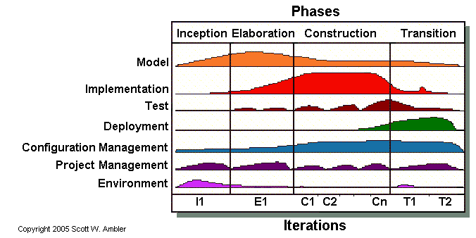
Iterations & Workflow of Unified Process

Slide 72
Inception Phase
The inception phase has the following objectives:
Gathering and analyzing the requirements.
Planning and preparing a business case and evaluating alternatives for risk management, scheduling resources etc.
Estimating the overall cost and schedule for the project.
Studying the feasibility and calculating profitability of the project.

Slide 73
Outcomes of Inception Phase
Project plan
Prototypes
Business
model
Inception
Initial risk
assessment
Initial business
case
Vision
document
Initial use
case model
Initial
project
Glossary

Slide 74
Elaboration Phase
The elaboration phase has the following objectives:
Establishing architectural foundations.
Design of use case model.
Elaborating the process, infrastructure & development environment.
Selecting component.
Demonstrating that architecture support the vision at reasonable cost & within specified time.

Slide 75
Outcomes of Elaboration Phase
Development plan
Revised risk
document
Preliminary
User manual
Elaboration
An executable
architectural
prototype
Architecture
Description
document
Use case
model
Supplementary
Requirements
with non functional
requirement

Slide 76
Construction Phase
The construction phase has the following objectives:
Implementing the project.
Minimizing development cost.
Management and optimizing resources.
Testing the product
Assessing the product releases against acceptance criteria

Slide 77
Outcomes of Construction Phase
Test
Outline
Operational
manuals
Documentation
manuals
Construction
Test Suite
A description
of the
current release
Software
product
User manuals

Slide 78
Transition Phase
The transition phase has the following objectives:
Starting of beta testing
Analysis of user’s views.
Training of users.
Tuning activities including bug fixing and enhancements for performance & usability
Assessing the customer satisfaction.

Slide 79
Outcomes of Transition Phase
Transition
User feedback
Product
release
Beta test reports

Slide 80
Selection of a Life Cycle Model
Selection of a model is based on:
Requirements
Development team
Users
Project type and associated risk

